Slide 1
Chapter 6 REQUIREMENTS QUALITY ASSURANCE
Source of PP slides :
- Lamsweerde, A. V. 2011. Requirements Engineering: From System goals to UML Models to Software Specification. 2nd ed.Wiley.
- Weigers, K. And Beatty, J. 2013. Software Requirements. 3rd edn. Microsoft Press.

Slide 2
Lesson Objectives
To understand the various techniques on requirements quality assurance:
Requirements inspections and reviews
Prototyping
Model Validation
Acceptance Tests

Slide 3
Chap.1: RE products and processes
alternative options
Chap. 2 & 3:
Chap. 4:
Elicitation
& Analysis
techniques
Evaluation
techniques
consolidated
start
agreed
requirements
requirements
Chap. 6:
Chap. 5:
Quality assurance
techniques
Spec/doc
techniques
documented requirements

Slide 4
Quality assurance at RE time
Errors & flaws in requirements documents ...
the most expensive, numerous, persistent, dangerous
different types: omission, contradiction, inadequacy, ambiguity, unmeasurability, noise, overspecification, poor structuring, opacity
QA task 1: find as many of these as possible in the RD by ...
validation: adequacy of RD items wrt real needs ?
verification: completeness, consistency of RD items ?
checks for other target qualities
non-ambiguity, measurability, feasibility, good structure, ...?
QA task 2: report defects, analyze their causes, fix them

Slide 5
Quality assurance at RE time (2)
Various products resulting from this phase
consolidated RD
acceptance test data, prototype
development plan
project contract
Complements the requirements evaluation phase (Chap.4):
later, more accurate analysis
along selected options
on detailed specifications

Slide 6
Requirements quality assurance: outline
Requirements inspections and reviews
The requirements inspection process
Inspection guidelines
Requirements inspection checklists
Prototyping
Model Validation
Acceptance Tests

Slide 7

Requirements inspections and reviews
Simple idea:
ask selected people to inspect the RD individually
meet to agree on list of problems to be fixed
Various forms
walkthroughs: internal inspection by project members
more structured: external reviewers, well-prepared meetings,
inspection reports, etc.
Fairly common for source code (Fagan inspections)
Empirical studies showed it effective for requirements too

Slide 8
A structured inspection-based QA process
determine reviewers, timing, scope of meetings, report format
collect defects, agree on serious ones,
analyze causes, recommend, report
revise according to
recommendations
Free mode: no directive on where to find what
Checklist-based: specific issues, defect types, RD parts
Process-based: specific role for each reviewer, specific procedure, defect type, focus, analysis technique
F more effective

Slide 9
Inspection guidelines
Inspection report should be...
informative, accurate, constructive
(no opinion, no offending comment)
standard structure with room for free comments, lightweight
may guide individual reviewing
Inspectors should be ...
independent from RD authors
representative of all stakeholders, different background
Inspection should come not too soon, not too late
shorter, repeated meetings are more effective
More focus required on critical parts
the more defects in some part, the more scrutiny(inspection) required

Slide 10
Inspection checklists
Aim: guide defect search towards specific issues
Defect-driven checklists
list of generic questions structured by defect type
Quality-specific checklists
specialize defect-driven questions to specifc NFR categories
safety, security, performance, usability, ...
sometimes based on guidewords
often focussed on omissions
Domain-specific checklists
further specialization to domain concepts & operations
for increased guidance in defect search
Language-based checklists
specialize defect-driven checklists to spec language constructs
support automation
F richer spec languages => more sophisticated checks

Slide 11

Defect-driven checklists: a sample
(Omissions?)
Is this precisely defined somewhere ?
Is there any hidden assumption required for this ?
Is the rationale for this made explicit somewhere ?
(Contradictions?)
Is this consistent with stated objectives or constraints?
(Inadequacies?)
Does this formulate what stakeholders really want?
(Ambiguities?)
Can this be interpreted differently ?
Any other statement using this term with a different meaning?
(Unmeasurability?)
Is there a fit criterion for this quality requirement?
Is this stated in a way discriminating from alternative options?

Slide 12
Defect-driven checklists: a sample (2)
(Noises?)
Is this relevant to system objectives or constraints?
Does the negation of this make any sense?
Any other statement using this under different terms?
(Overspecification?)
Does this entail/mean premature design choices - any sensible alternative?
(Unfeasibility?)
Is this implementable within reasonable time/budget?
(Unintelligibility?)
Is this comprehensible by anyone needing to use it?
(Remorse ?) - deep regret/ guilt
Has this concept been used already before this definition?

Slide 13
Defect-driven checklists: a sample (3)
(Poor structuring?)
Is the structuring rule for those sections apparent, and natural ?
Any item related to this and described elsewhere?
Is this covering unrelated requirements?
Is this mixing requirements and assumptions altogether?
Is this mixing requirements and domain properties?
Any unnecessary mixing of functional & non-functional concerns?
(Opacity?) – blur/ not transparent
Any inderdependent items whose dependencies are not made visible?
(Poor modifiability?)
Would any change to this require propagation throughout major portions of the RD?

Slide 14
Inspection checklists
Aim: guide defect search towards specific issues
Defect-driven checklists
list of generic questions structured by defect type
Quality-specific checklists
specialize defect-driven questions to specifc NFR categories
safety, security, performance, usability, ...
sometimes based on guidewords
often focussed on omissions
Domain-specific checklists
further specialization to domain concepts & operations
for increased guidance in defect search
Language-based checklists
specialize defect-driven checklists to spec language constructs
support automation
F richer spec languages => more sophisticated checks

Slide 15
Quality-specific checklists: a sample
Any unspecified response to out-of-range input values?
Any unspecified response to receiving expected input values too early; too late; or never?
Is the OR of input conditions on this operation a tautology/ redundancy?
Any recovery operation in case of input saturation?
Any output producible faster than it can be consumed?
Any input from sensors unused by the software controller?
Does every state sequence from a hazardous state lead to a low-risk state?
Is there a data consistency check before a decision is made from these data?

Slide 16
Inspection checklists
Aim: guide defect search towards specific issues
Defect-driven checklists
list of generic questions structured by defect type
Quality-specific checklists
specialize defect-driven questions to specifc NFR categories
safety, security, performance, usability, ...
sometimes based on guidewords
often focussed on omissions
Domain-specific checklists
further specialization to domain concepts & operations
for increased guidance in defect search
Language-based checklists
specialize defect-driven checklists to spec language constructs
support automation
F richer spec languages => more sophisticated checks

Slide 17
Language-specific checklists: a sample for statement templates
Is this statement identifier used consistently throughout the RD?
Does the indicated type for this statement correctly refer to a requirement, assumption, domain property, or definition?
Is this fit criterion defined in terms of measurable quantities & measurement protocols?
Is this rationale consistent with the stated system objectives?
Is this priority consistent with the priority of other requirements this requirement contributes to?

Slide 18
Language-specific checklists: checks on formal specs
i) Syntax checking
Well formed according to the syntax rules
ii) Type checking
variable must have type and every use it consistently
iii) Static semantics checking
each variable must declared and have a specific initial value, also must use within the scope
iv) Circularity checking
No variable is being defined in terms of itself

Slide 19
Language-specific checklists: checks on formal specs (examples…)
Is the type of the right-hand-side of this equational postcondition compatible with the declared type of the left-hand-side output variable?
If the output variable in this Z operation schema is a partial function, is there a precondition to specify where this variable is fully defined?
Is this precondition consistent with invariants in the imported Z data schemas?
Is there an exception schema for the case where this precondition does not hold?
Does this OR-combination of Z schemas cover all possible cases?
F Can be automated by tools

Slide 20
Language-specific checklists: Checking decision tables
N input conditions
number of case combinations < 2^{N}
=> missing cases
(number of case combinations > 2^{N}
=> redundant cases )

Slide 21
Requirements inspections and reviews: strengths & limitations
J Experienced to be even more effective than code inspection
process-based mode with mix of defect-based, quality-specific, domain-specific, language-specific checklists
J Wide applicability
any defect type, any spec format
L Burden & cost of inspection process
size of inspection material
required time/cost for external inspectors, review meetings
L No guarantee of not missing important defects

Slide 22
Requirements quality assurance: outline
Requirements inspections and reviews
The requirements inspection process
Inspection guidelines
Requirements inspection checklists
Prototyping
Model Validation
Acceptance Tests

Slide 23
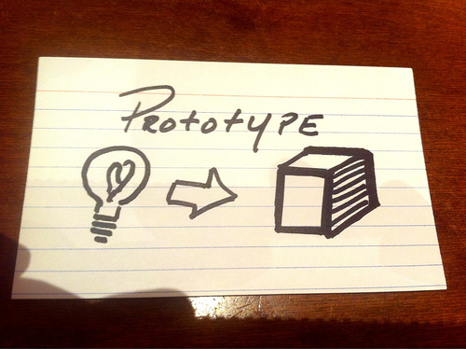
Prototyping
It’s hard to visualize how a system will function under specific circumstances just by reading the requirements
Prototypes are validation tools that make the requirements real
They allow the user to experience some aspects of what a system based on the requirements would be like
Prototypes can be used to validate whether the requirements:
Meet users’ needs
Complete
Feasible
Clearly communicated
Etc

Slide 24

Prototyping
For eg: a simple as a paper mock-up can be used to walk through use cases, processes, or functions to detect any omitted or erroneous requirements.
Prototypes also help confirm that stakeholders have a shared understanding of the requirements.
Additional levels of sophistication in prototypes, such as simulations, allow more precise validation of the requirements; however, building more sophisticated prototypes will also take more time.
Among others, 2 main types of prototypes can be used to validate requirements:
Mock-up Prototyping
Proof-to-concept Prototyping

Slide 25
Prototyping
Mock-up Prototypes
also called a horizontal prototype
focuses on a portion of the user interface; it doesn’t dive into all the architectural layers or into detailed functionality.
It displays the facades of user interface screens and permits some navigation between them, but it contains little or no real functionality
It lets you explore some specific behaviors of the intended system, with the goal of refining the requirements.

Slide 26
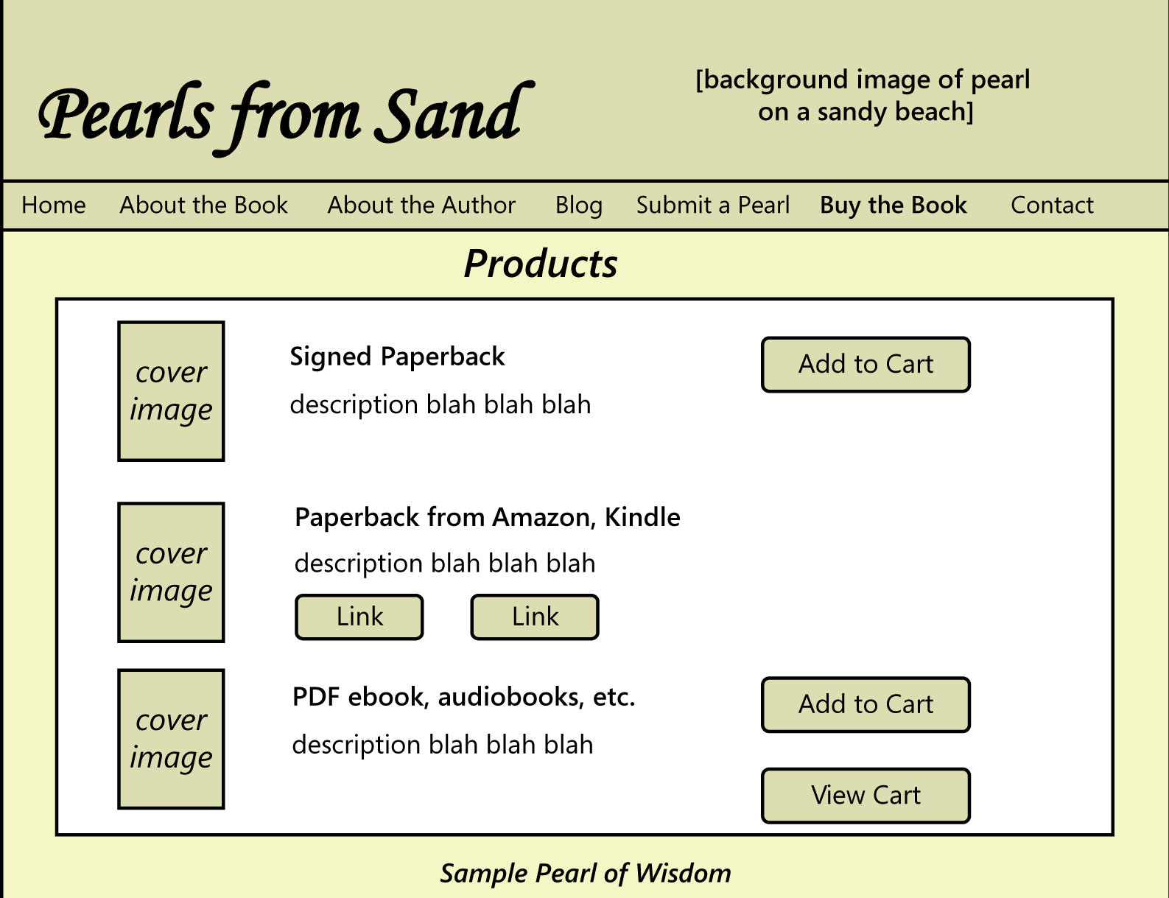
Example : Mock-up Prototype
FIGURE: Sample wireframe of one page for PearlsFromSand.com.

Slide 27

Prototyping
Proof-of-concept prototypes
also known as a vertical prototype
can demonstrate that the requirements are feasible
implements a slice of application functionality from the user interface through all the technical services layers.
It works like the real system is supposed to work because it touches on all levels of the system implementation.
Use when you’re uncertain whether a proposed architectural approach is feasible and sound, or when you want to optimize algorithms, evaluate a proposed database schema, confirm the soundness of a cloud solution, or test critical timing requirements
To make the results meaningful, such prototypes are constructed by using production tools in a production-like operating environment.

Slide 28
Prototyping Evaluation
Have the right people evaluate the prototype from the appropriate perspectives
Include members of multiple user classes, both experienced and inexperienced
Stress that it addresses only a portion of the functionality
Create a non judgmental environment in which the evaluators feel free to express their thoughts, ideas, and concerns
Avoid coaching users on the “right” way to perform some function with the prototype
Document what you learn from the prototype evaluation:
Use the information from a mock-up prototype to refine the requirements
For a proof of concept, document the evaluations, results and the decisions you made about the technical approaches explored

Slide 29
Prototyping Evaluation
You might also ask general questions like the following during requirements validation process with prototyping:
Does the prototype implement the functionality in the way you expected?
What functionality is missing from the prototype?
Can you think of any possible error conditions that the prototype doesn’t address?
Are any unnecessary functions present?
How logical and complete does the navigation seem to you?
Are there ways to simplify any of the tasks that require too many interaction steps?
Were you ever unsure of what to do next?

Slide 30
Prototyping Risks
Pressure to release the prototype - stakeholder will see a running throwaway prototype and conclude that the product is nearly completed
Distraction by details – work with real-looking prototypes, users might too focus on user interfaces and forget the primarily concerned with conceptual issues at the requirements stage
Unrealistic performance expectations - users will infer the expected performance of the final product from the prototype’s performance
Investing excessive effort in prototypes - This can happen when you are prototyping the whole solution rather than only the most uncertain, high-risk, or complex portions

Slide 31
Requirements quality assurance: outline
Requirements inspections and reviews
The requirements inspection process
Inspection guidelines
Requirements inspection checklists
Prototyping
Model Validation
Acceptance Tests

Slide 32

Model validation
It is necessary to validate the quality of the models developed during requirements analysis and specification
4 types of models created during requirements analysis and specification (refer to chapter 3 & 5):
Context Models
Interaction Models
Structural Models
Behavioral Models

Slide 33
Requirements Model validation & verification
Verification determines whether the product of some development activity meets its requirements (doing the thing right). Validation assesses whether a product satisfies customer needs (doing the right thing).
Extending these definitions to requirements model:
Verification determines whether you have drawn the requirements models right: your requirements models have the desirable properties described in Chapter 3 & 5.
Validation of requirements models assesses whether you have drawn the right requirements models: they trace back to business objectives.

Slide 34
Requirments Model valiadtion Example - Use Case validation
Business requirement
one of the primary business objectives for the Chemical Tracking System was to:
Reduce chemical purchasing expenses by 25% in the first year.
Use Case
A use case that aligns with this business requirement is “Request a Chemical.” This use case includes a path that permits the user to request a chemical container that’s already available in the chemical stockroom. (As shown in next slide)
Here’s the Use Case Description:
The Requester specifies the desired chemical to request by entering its name or chemical ID number or by importing its structure from a chemical drawing tool. The system either offers the Requester a container of the chemical from the chemical stockroom or lets the Requester order one from a vendor.

Slide 35
Example - Use Case validation
FIGURE : Partial use case diagram for the Chemical Tracking System.

Slide 36
Model Verification: intra- and inter-diagram Checks (examples…)
Any external entity in Context Diagram which is not relevant to the system?
Any input and output data flow of the lower-level DFDs not found in level-0 DFD (Context Diagram)?
Any relationship in ER diagram with inadequate multiplicities?
Any Use Case diagrams with inadequate include or extend relationships?
Any relationship in Class diagram with inadequate multiplicities?
Is this object communication (message) in Sequence Diagram declared in respective class in Class Diagram?
Any state diagram has multiple initial state?
(Let’s discuss some other examples in lecture … )
Can be automated by tools

Slide 37
Ex: Let’s discuss…
Let’s discuss other example of intra- and inter- diagram checks …
Intra diagram checks:
DFD diagram –
Use case diagram –
Inter diagram checks:
DFD & ERD –
Class diagram & Sequence diagram –

Slide 38
Requirements quality assurance: outline
Requirements inspections and reviews
The requirements inspection process
Inspection guidelines
Requirements inspection checklists
Prototyping
Model Validation
Acceptance Tests

Slide 39
Acceptance Test
Customers assess whether a system satisfies its predefined acceptance criteria.
Acceptance criteria—and hence acceptance testing—should evaluate whether the product satisfies its documented requirements and whether it is fit for use in operating environment
Having users devise acceptance tests is a valuable contributor to effective requirements development
The earlier that acceptance tests are written, the sooner they can help the team filter out defects in the requirements

Slide 40
Defining acceptance criteria
Creators of acceptance tests should consider the most commonly performed and most important usage scenarios when deciding how to evaluate the software’s acceptability.
Focus on testing the normal flows of the use cases and their corresponding exceptions, devoting less attention to the less frequently used alternative flows.

Slide 41
Defining acceptance criteria
Acceptance criteria could also encompass dimensions such as the following:
Specific high-priority functionality that must be present
Essential nonfunctional criteria or quality metrics that must be satisfied
Remaining open issues and defects
Specific legal, regulatory, or contractual conditions
Supporting transition, infrastructure , or other project (not product) requirements

Slide 42
Acceptance criteria
J The value in writing acceptance tests is it guides users to think about how the system will behave following implementation.
L The problem with writing only acceptance tests is that the requirements exist only in people’s minds. By not documenting and comparing alternate views of requirements—user requirements, functional requirements, analysis models, and tests—you can miss an opportunity to identify errors, inconsistencies, and gaps.

Slide 43
ANY QUESTION…

